Slide 1


Brandon Dorman
3/26/2023

Slide 2

Outline
Executive Summary
Introduction
Methodology
Results
Conclusion
Appendix

Slide 3
Executive Summary
Used machine learning libraries such as MatPlotLib and SkLearn to analyze the significance of various aspects of SpaceX’s landing facilities and accuracy.
In the sample data of 18 launches, we achieved accuracy of 83%.

Slide 4
Introduction
We wanted to analyze flight data to see patterns in how location, payload and flight numbers of components influenced the eventual correctness of the flight.
We wanted to see how the flight number and payload affected the final outcome and why.

Slide 5

Section 1

Slide 6
Methodology
Executive Summary
Data collection methodology:
We pulled the data from SpaceX’s API (well, Coursera’s, but the CSV’s came from SpaceX)
Perform data wrangling
Perform exploratory data analysis (EDA) using visualization and SQL
Perform interactive visual analytics using Folium and Plotly Dash
Perform predictive analysis using classification models
How to build, tune, evaluate classification models

Slide 7
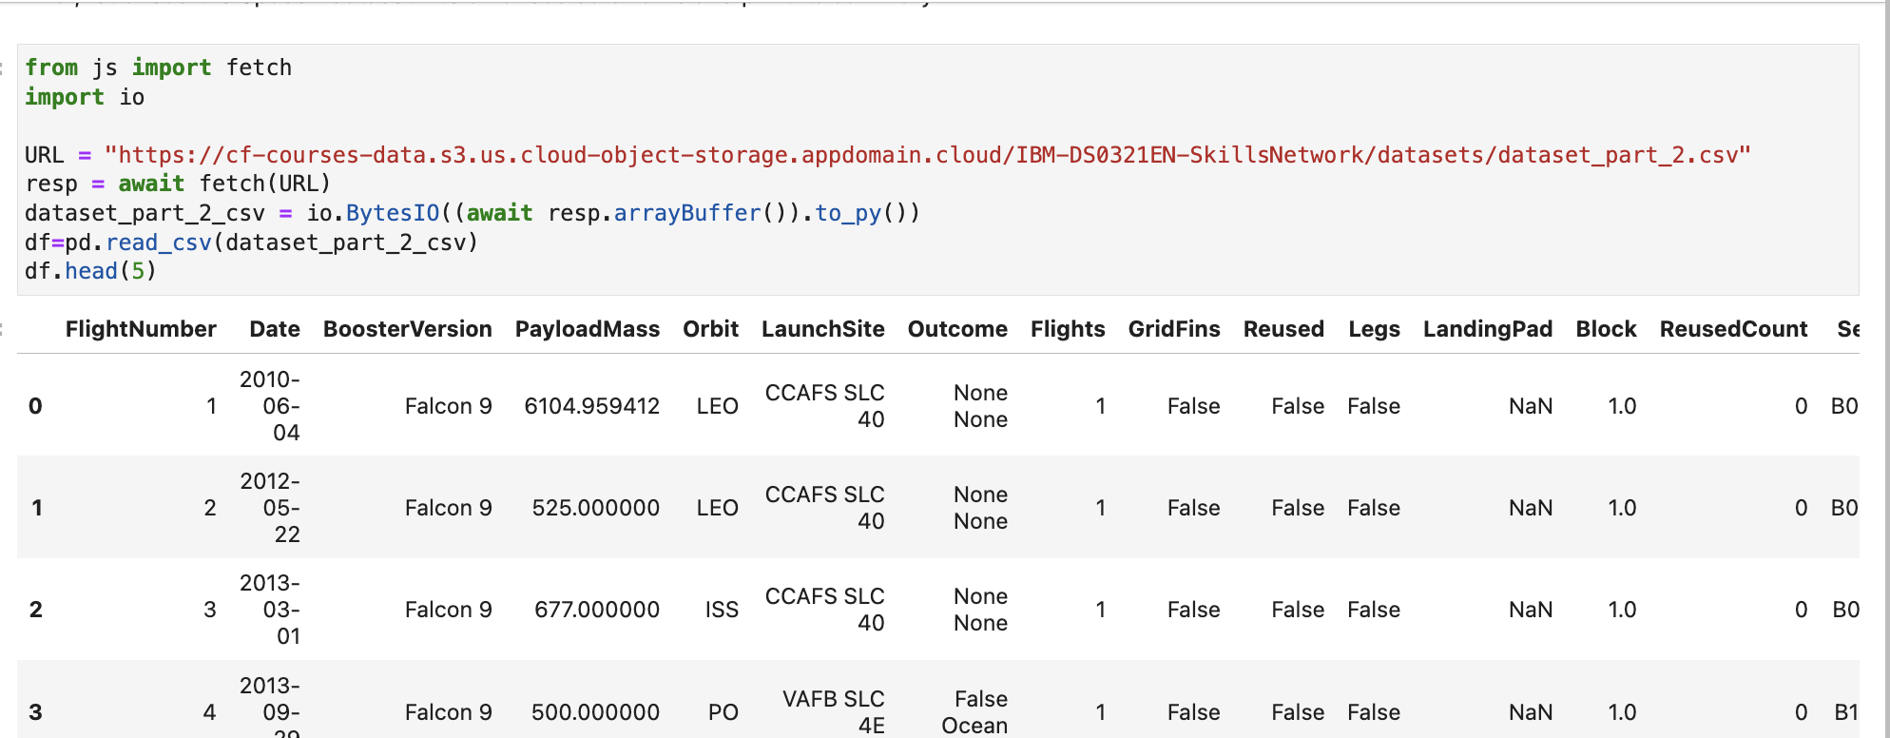
Data Collection
Data was collected via SpaceX API.
Flowcharts on following pages

Slide 8
Data Collection – SpaceX API
SpaceX:
Spacex_url=‘https://api.spacexdata.com/v4/launches/past
Add the GitHub URL of the completed SpaceX API calls notebook (https://github.com/brandonopened/courserafinal/blob/main/jupyter-labs-eda-dataviz.ipynb),
Import fetch library
Send URL
Create dataframe of data with pandas

Slide 9
Data Collection - Scraping
BeautifulSOAP object
Soup = BeautifulSoup(html_data,”html.parser”)
Create Data Dictionary
Def date_time(table_cells) etc
Df=pdf.DataFrame(launch_dict)
Files:
https://github.com/brandonopened/courserafinal/blob/main/lab_jupyter_launch_site_location.ipynb
HTTP Get command
Beautiful Soup library to create dataframe
convert dataframe to CSV for readability
Create Dictionary with launch records

Slide 10
Data Wrangling
Processed the data using EDA (Exploratory Data analysis) to find patterns in labeled and unlabeled data for training.
I processed details of mission outcomes such as landing site, payload etc.
https://github.com/brandonopened/courserafinal/blob/main/lab_jupyter_launch_site_location.ipynb

Slide 11
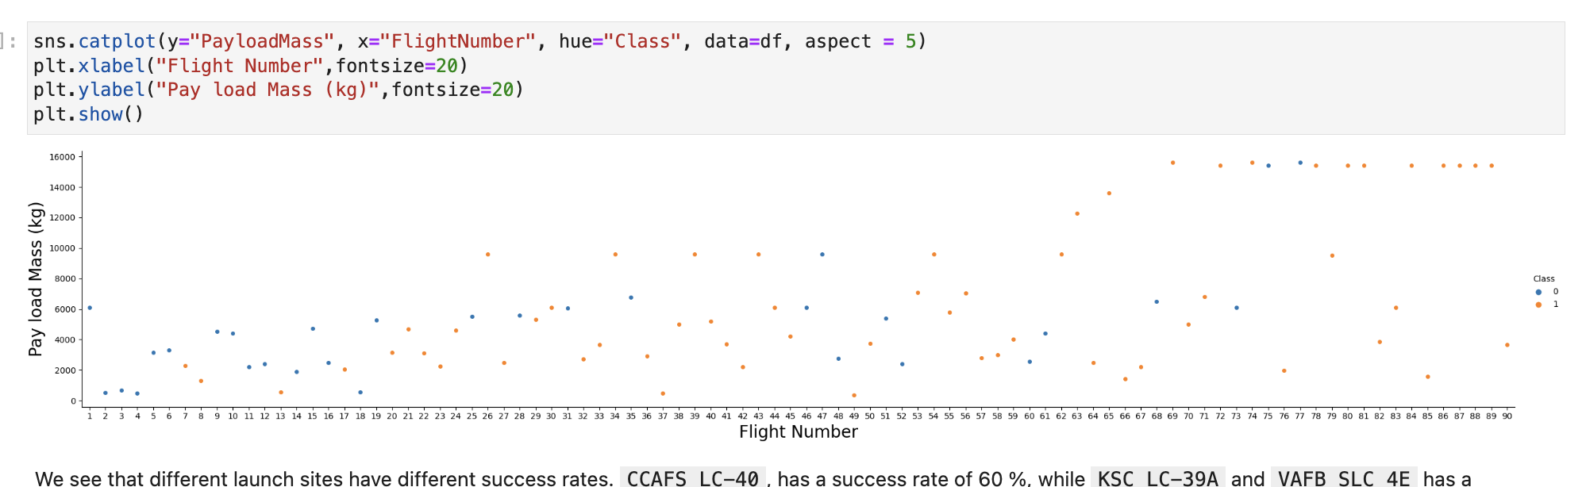
EDA with Data Visualization
I used folium to create interactive charts of launch data
https://github.com/brandonopened/courserafinal/blob/main/lab_jupyter_launch_site_location.ipynb

Slide 12
EDA with SQL
Display the names of the unique launch sites in the space mission
Display the total payload mass carried by boosters launched by NASA (CRS)
Display 5 records where launch sites begin with 'CCA’
Display average payload mass carried by booster version F9 v1.1
List the date when the first successful landing outcome on a ground pad
List the names of the boosters which have success in drone ship and have payload mass greater than 4000 / less than 6000
Total number of successful and failure mission outcomes
List the names of the booster versions which have carried the maximum payload mass. Use a subquery
List the failed landing outcomes in drone ship, their booster versions, and launch site names for in year 2015
10.Rank the count of landing outcomes (such as Failure (drone ship) or Success (ground pad))
between the date 2010-06-04 and 2017-03-20, in descending order

Slide 13
Build an Interactive Map with Folium
Added ‘folium.circle’ and ‘folium.marker’ for each launch site
Focused on these objects to show success and failure of each launch site
Added MousePosition() to get points on the map
Added folium.Polyline() to draw a line between the map and launch site
Add the GitHub URL of your completed interactive map with Folium map, as an external reference and peer-review purpose
Link

Slide 14
Build a Dashboard with Plotly Dash
Summarize what plots/graphs and interactions you have added to a dashboard
Added Payload range slider
Added Scatter Chart for payload -> mission outcomes
Added launch Site Dropdown component to filter by launch sites
Explain why you added those plots and interactions
Wanted to be able to drill down into exactly which interactions with other variables contributed to the success or failure of each launch site
Most successful launches: KSC LC-39A (10) and 76.9% success rate
Paload Range with highest success 2-5K KG
FT booster highest launch success rate
Github Link

Slide 15
Predictive Analysis (Classification)
Best performing classification model
Created logistic regression model. Trained and tested accuracy
Created KNN algorithm
Created SVM algorithm and tested
Created Decision Tree
Alg Type | Accuracy | Test Data Score
KNN | .8482 | .833
SVM | .8482 | .833
Decision Tree | .875 | .833
Logistic Regression | .8464 | .833

Slide 16
Predictive Analysis (Classification) Continued
Read Dataset into DF
Normalize the data
Train/Test/Split the data
Create and Refine Models (on previous page)
Determine best model

Slide 17
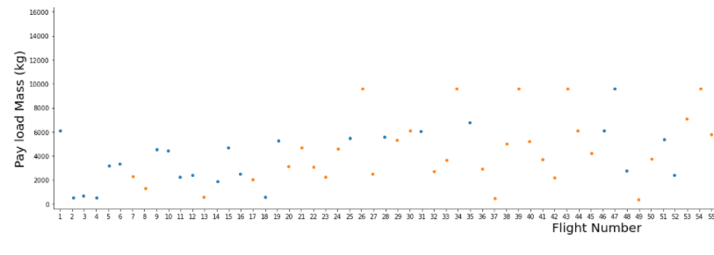
Results
Exploratory data analysis results

Slide 18
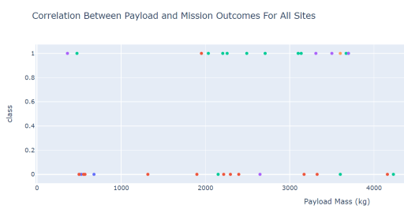
Results
Interactive analytics demo in screenshots

Slide 19
Results
Predictive analysis results
Alg Type | Accuracy | Test Data Score
KNN | .8482 | .833
SVM | .8482 | .833
Decision Tree | .875 | .833
Logistic Regression | .8464 | .833

Slide 20

Section 2

Slide 21
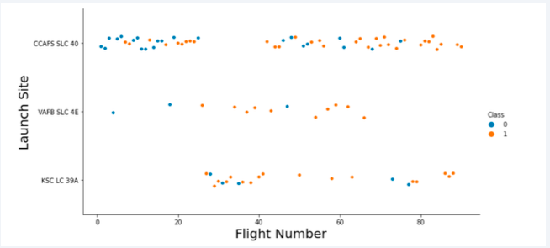
Flight Number vs. Launch Site
Scatterplot of Flight Number vs. Launch Site
Success increases as number of flights increase
KSC LC 39A takes about 25 launches before a successful launch

Slide 22
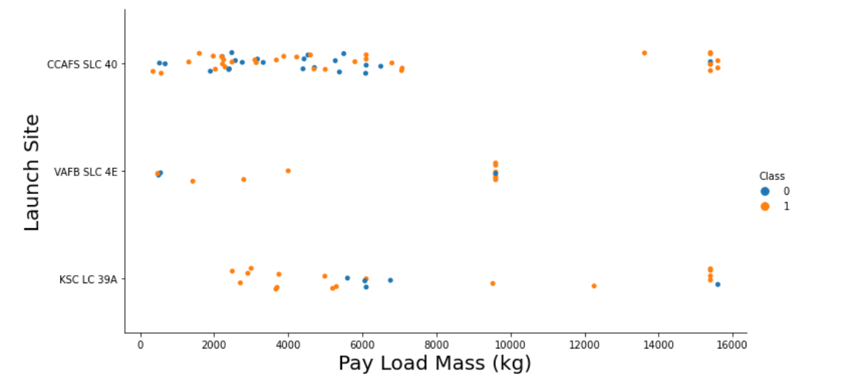
Payload vs. Launch Site
scatter plot of Payload vs. Launch Site
Percentage of successful launch (class 1) increases as payload increase

Slide 23
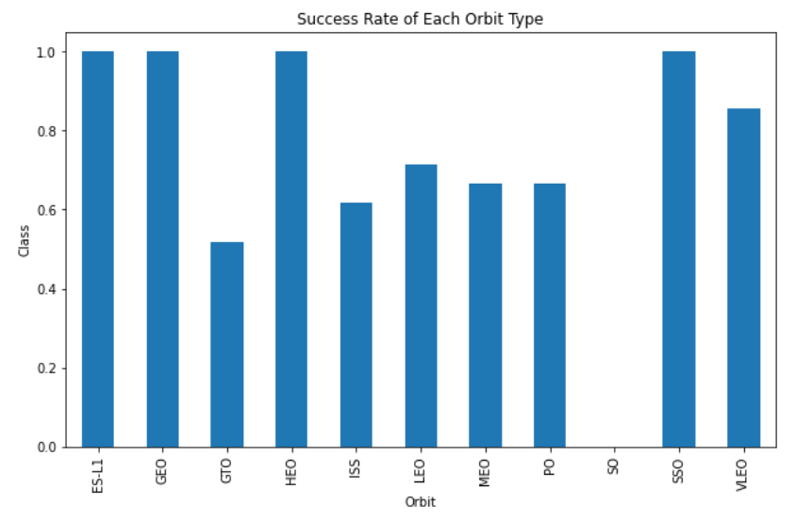
Success Rate vs. Orbit Type
Bar chart for the success rate of each orbit type
Orbits ES-LI, GEO, HEO and SSO have the highest success rates
GTO orbit has the lowest success rate

Slide 24
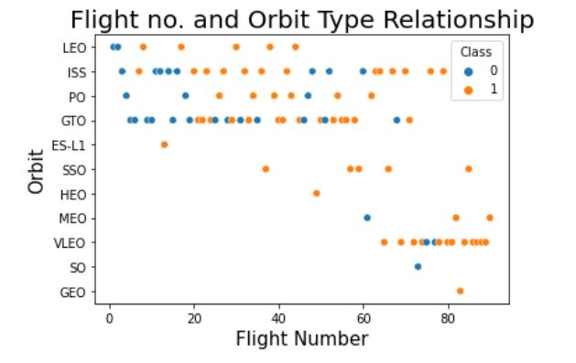
Flight Number vs. Orbit Type
Scatter point of Flight number vs. Orbit type
For most orbits successful landing rates increase with flight numbers (practices)
No relationship between flight number and orbit for GTO

Slide 25
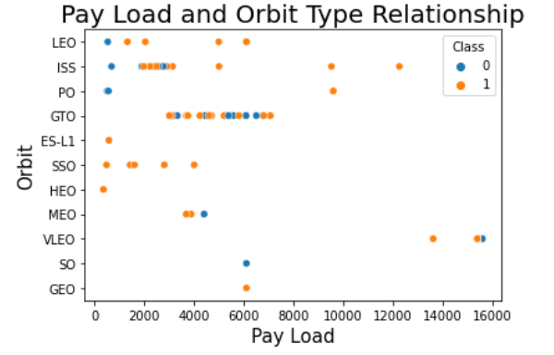
Payload vs. Orbit Type
Show a scatter point of payload vs. orbit type
The higher the payload for orbits ISS, PO, SSO, LEO the greater the chance of a successful landing

Slide 26
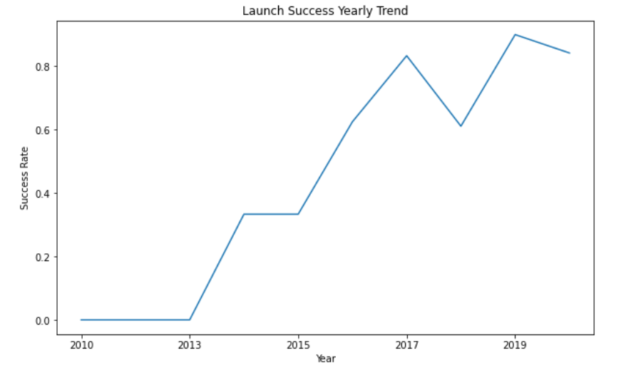
Launch Success Yearly Trend
Show a line chart of yearly average success rate
Success (1) increased around 80% between 2013 and 2020
Success rates declined between 2017 and 2020.

Slide 27
All Launch Site Names
Find the names of the unique launch sites
Present your query result with a short explanation here
Select distinct Launch_site from spacexbl
I used distinct to avoid post processing of removing of duplicates. There are four unique sites:
CCAFS LC-40, CCAFS SLC-40, KSC LC-39A, VAFB SLC-4E

Slide 28
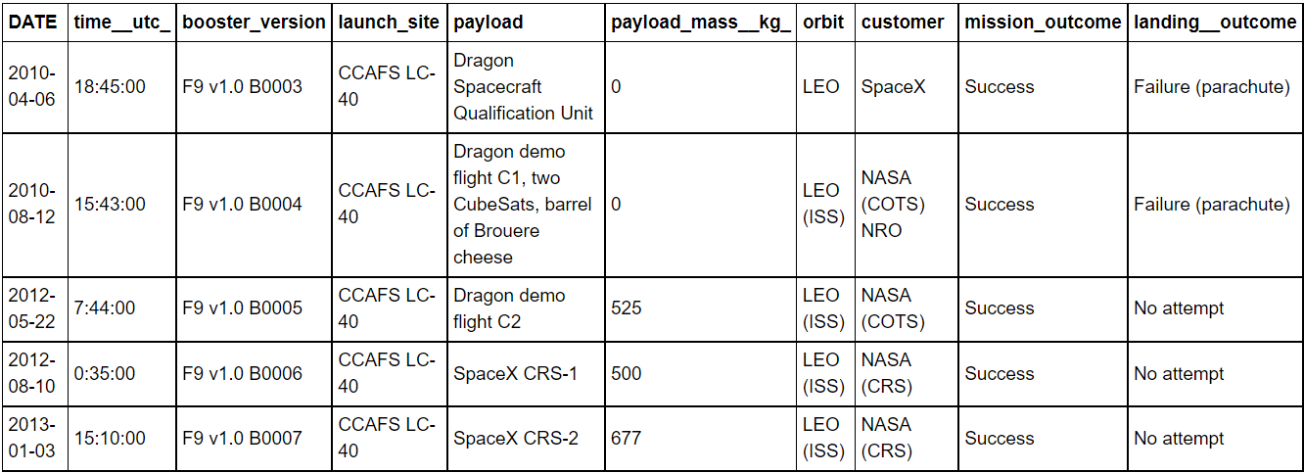
Launch Site Names Begin with 'CCA'
Find 5 records where launch sites begin with `CCA`
Present your query result with a short explanation here
select * from spacexbtl where launch_site like ‘CCA%’ limit 5

Slide 29
Total Payload Mass
Calculate the total payload carried by boosters from NASA
Present your query result with a short explanation here
Select sum(PAYLOAD_MASS_KG_) from spacextbl where Customer = ‘NASA (CRS)’
Sum adds the payload and NASA customers together, the result is 45596 !

Slide 30
Average Payload Mass by F9 v1.1
Calculate the average payload mass carried by booster version F9 v1.1
Present your query result with a short explanation here
Select avg(PAYLOAD_MASS_KG_) from spacextbl where Booster_Version LIKE ‘F9 v1.1’
here, avg shows the average payload mass for booster F9 V1.1 , which is 2928

Slide 31
First Successful Ground Landing Date
Find the dates of the first successful landing outcome on ground pad
Present your query result with a short explanation here
Select min(Date) as min_date from spacextbl where Landing_Outcome = ‘Success (ground pad)’
Here I used min(date) to find the first date and then narrowed down the criteria to where the landing outcome was a success.
2015-12-22 was the first successful landing date.

Slide 32
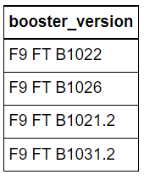
Successful Drone Ship Landing with Payload between 4000 and 6000
List the names of boosters which have successfully landed on drone ship and had payload mass greater than 4000 but less than 6000
Present your query result with a short explanation here
Select Booster_version from spacexbl where (PAYLOAD_MASS_KG_> 4000 and PAYLOAD_MASS_KG_ < 6000) and (Landing_Outcome = ‘Success (drone ship)’);
The query shows where the payload is greater than 4000 but less than 6000 KG and is a success

Slide 33
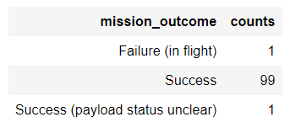
Total Number of Successful and Failure Mission Outcomes
Calculate the total number of successful and failure mission outcomes
Present your query result with a short explanation here
Select Mission_Outcome, count(Mission_Outcome) as counts from spacextbl group by Mission_Outcome
Using Group to sort by mission outcome and shows outcomes by mission type

Slide 34
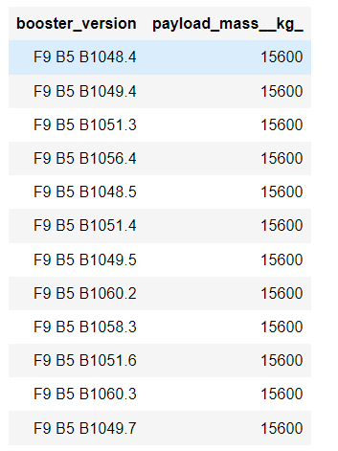
Boosters Carried Maximum Payload
List the names of the booster which have carried the maximum payload mass
Select Booster_Version, PAYLOAD_MASS_KG_ from spacexbtl where PAYLOAD_MASS_KG = (select max(PAYLOAD_MASS_KG_) from spacextbl

Slide 35
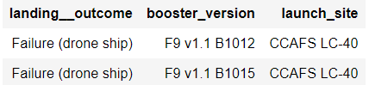
2015 Launch Records
List the failed landing_outcomes in drone ship, their booster versions, and launch site names for in year 2015
Select Landing_Outcome, Booster_version, Launch_Site from spacexbtl whereLanding_Outcome = ‘failure (drone ship)’ and year(Date) = ‘2015’
Here we list landing outcome, booster version, and launch site for the year 2015

Slide 36
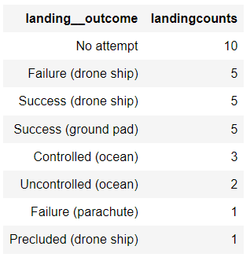
Rank Landing Outcomes Between 2010-06-04 and 2017-03-20
Rank the count of landing outcomes (such as Failure (drone ship) or Success (ground pad)) between the date 2010-06-04 and 2017-03-20, in descending order
Select Landing_Outcome, count(*) as LandingCounts from spacextbl where Date between ‘2010-06-04’ and ‘2017-03-20’. Group by Landing_Outcome order by count(*) desc;

Slide 37

Section 3

Slide 38
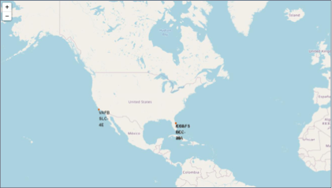
Space X Launch Sites
Shows global launch sites at Vandenburg Air Force base and in Florida (Kennedy Space Center and Cape Canerval)

Slide 39
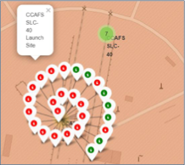
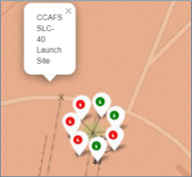
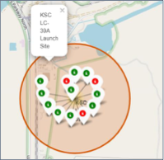
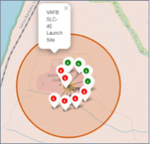
Color Labeled Launch Outcomes
CCAFS SLC-40 with
markers
CCAF SLC-40 with markers
VAFB Launch Site
CCAFS SELC-40 with markers

Slide 40
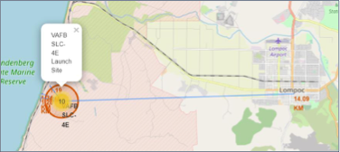
Vandenburg AFB and location to proximities
This shows Vandenberg AFB and how close it is to Lompoc, the nearest town. I’m from California but didn’t realize how close it was to Lompoc which I’ve visited.

Slide 41

Section 4

Slide 42
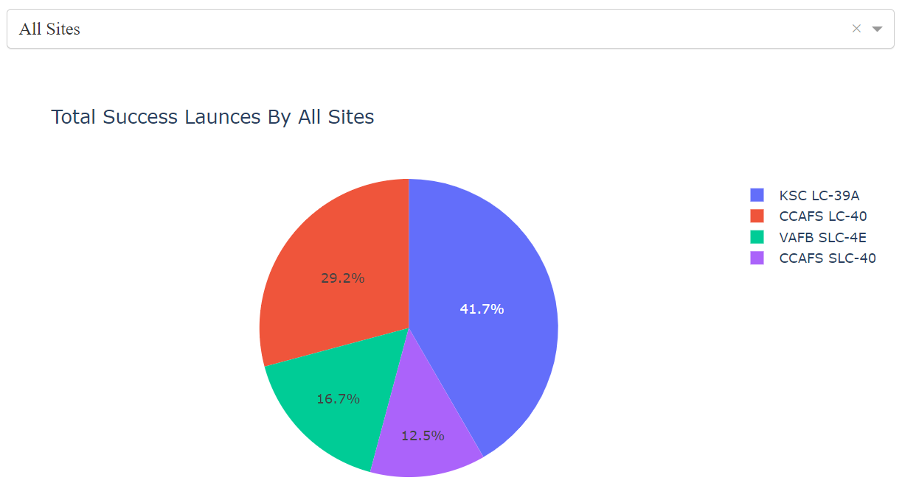
Launch Success Counts
KSC LC-39A has the highest
Launch success rate, with CCAFS-SELC-40 the lowest

Slide 43
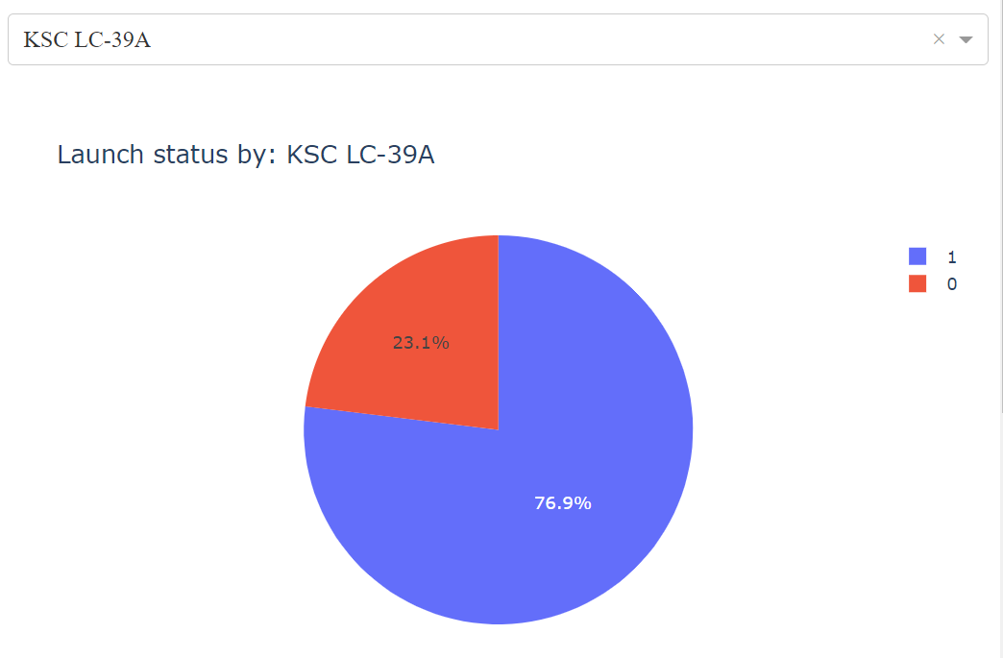
Highest Launch Success Ratio
KSC LC-39A has the highest launch
The rate is 76.9%
Launch success failure is 23.1%

Slide 44
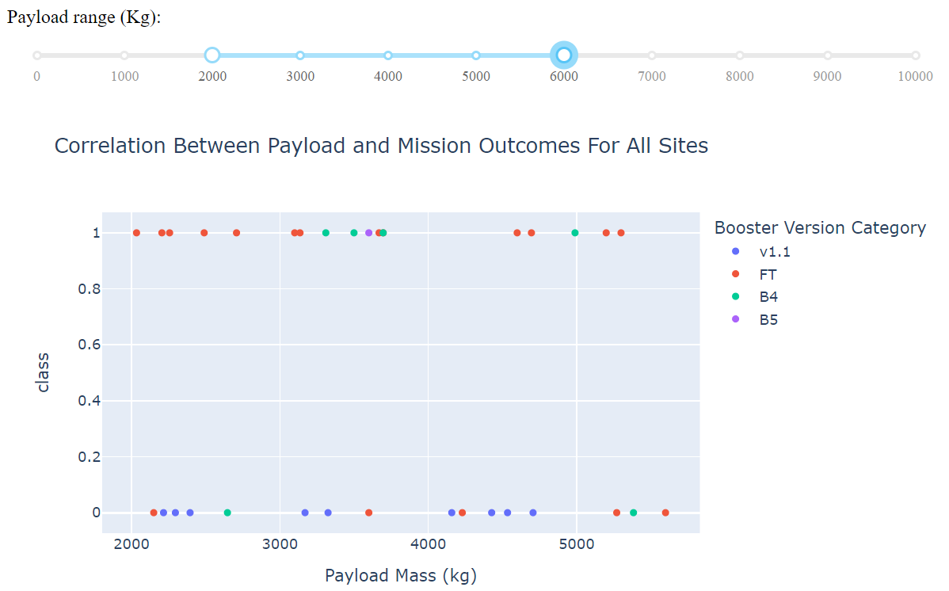
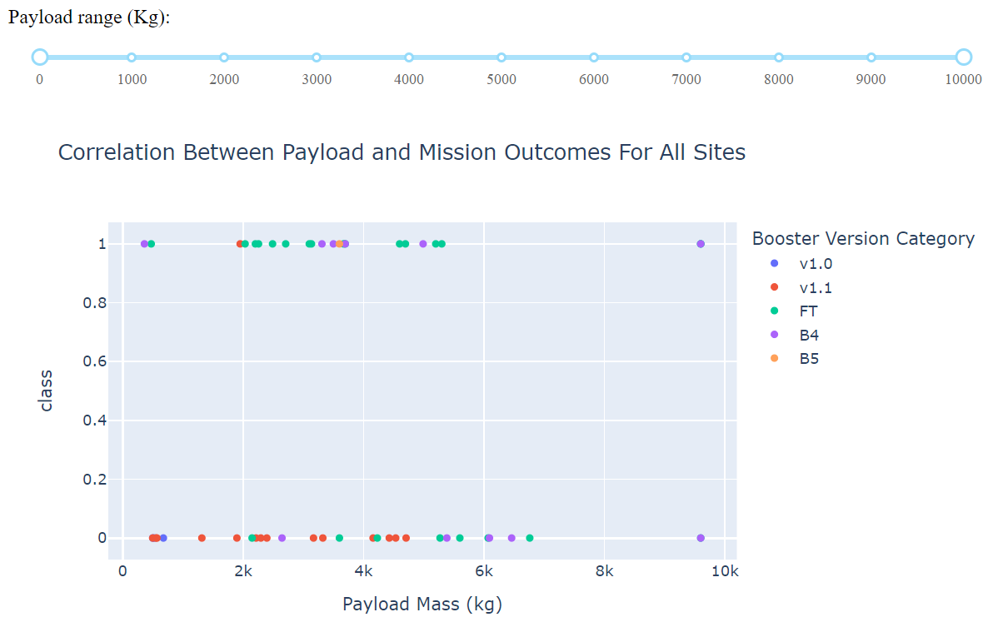
Payload vs. Launch Outcome scatter plot for all sites
These two screenshots show payload launches of 2-6K and up to 10K. The most successful launches were between 2K to 5.5K

Slide 45

Section 5

Slide 46
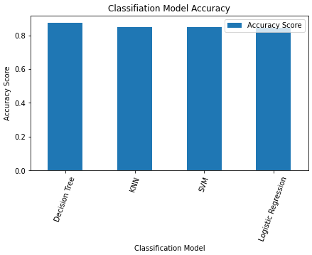
Classification Accuracy
See Built model accuracy for all built classification models, in a bar chart
The model with the highest accuracy is Decision Tree with a value of .8750

Slide 47
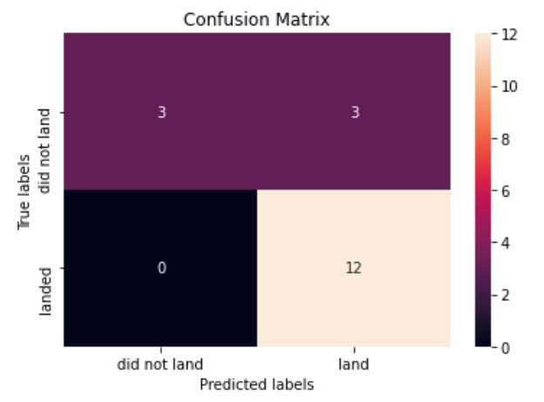
Confusion Matrix
The same confusion matrix was used for all models.
There were 18 predictions
The classifier was correct 83% of the time with an error rate of about 16.5%

Slide 48
Conclusions
Success rates go up as payload increases but also seemingly with time
Launch site KSC LC-39A has the highest launch success rate
Launch sites are located away from cities and closer to coastlines
The best performing machine learning classification model was decision tree probably due to the somewhat limited dataset and simplicity of the model.

Slide 49
Appendix
Notebooks are on github at https://github.com/brandonopened/courserafinal

Slide 50


